Slide 1
! jetpackJoyride
CSSE220 Final Project
Beckett Arial | Rowan Sammon | Nicolas Kireyev

Slide 2


01
SYSTEM DESIGN
( Design Decisions and Design principles)
Notes:
Rowan

Slide 3
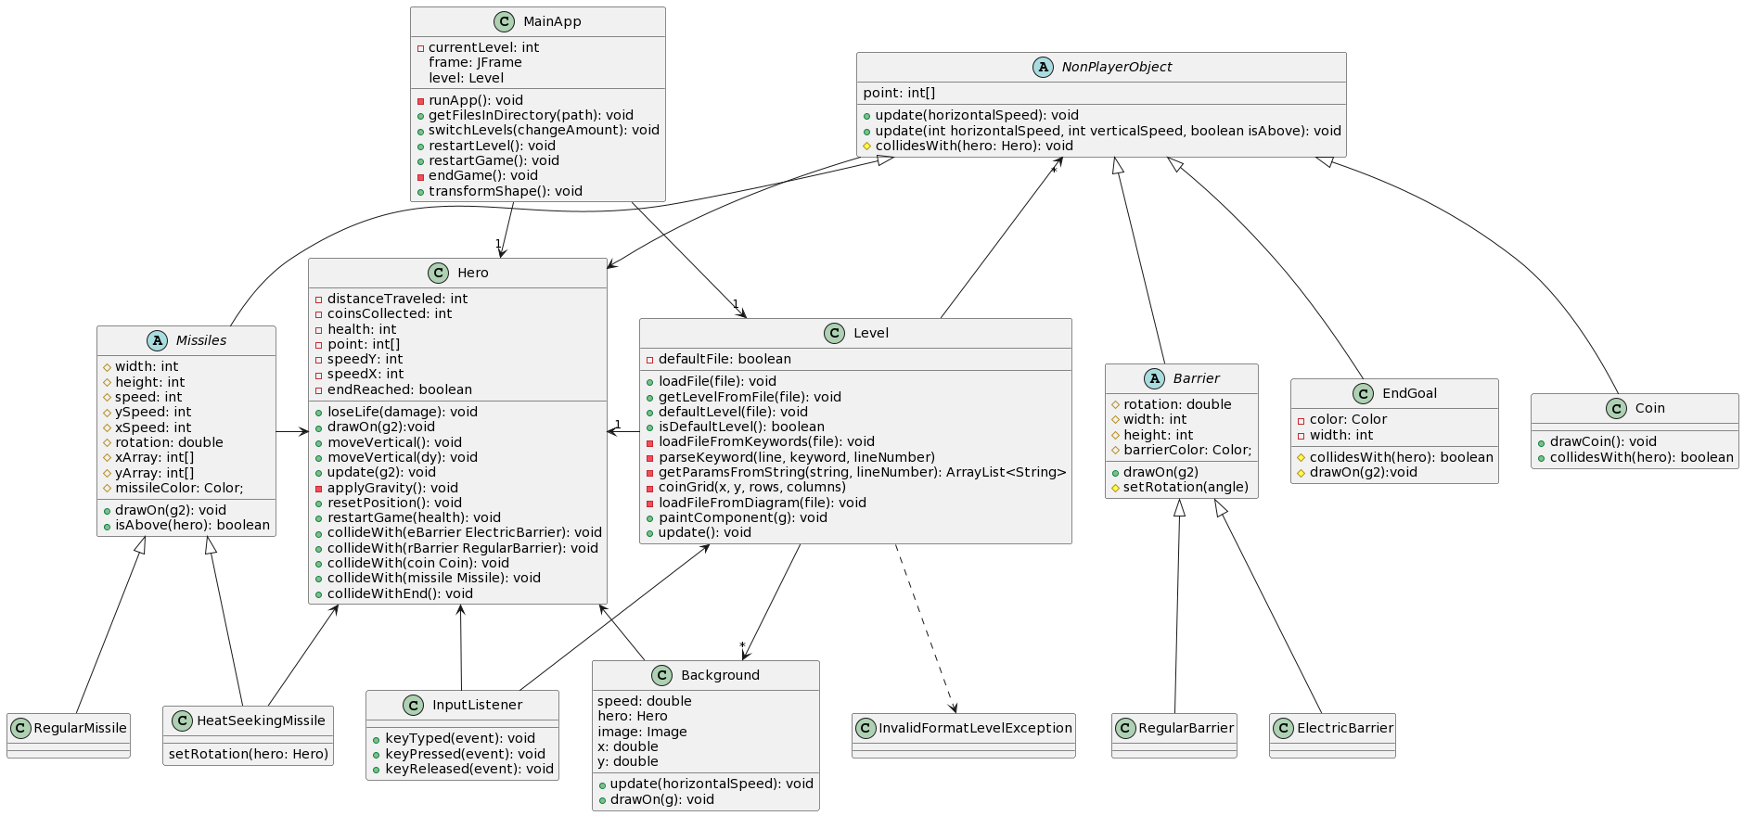
Notes:
Rowan

Slide 4
02
FEATURES
Design features, Required Features, & Additional Features
Notes:
Beckett

Slide 5
BASIC FEATURES
Electric Barrier
Regular Barrier
Regular Missile
Heat Seeking Missile
Coin
Hero
Notes:
Beckett

Slide 6
SIDE
SCROLLING
Notes:
Nicolas

Slide 7

PARALLAX
Several layered of images are used.
Each image has 2 copies in the level that scroll.
Once one has reached the far edge (fully off screen) it is placed back at the beginning and continues to scroll.
The images scroll at different speeds to create the illusion of perspective
Sourced from media
This file is made available under the Creative Commons CC0 1.0 Universal Public Domain Dedication.
Notes:
Rowan

Slide 8

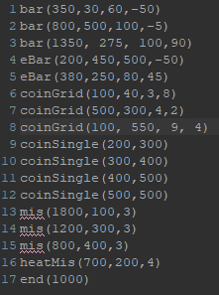
LEVEL 4 TXT FILE:

Slide 9
03
PROBLEM
( Regular Barrier Collisions )
Notes:
Nicolas

Slide 10
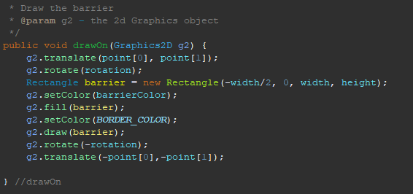
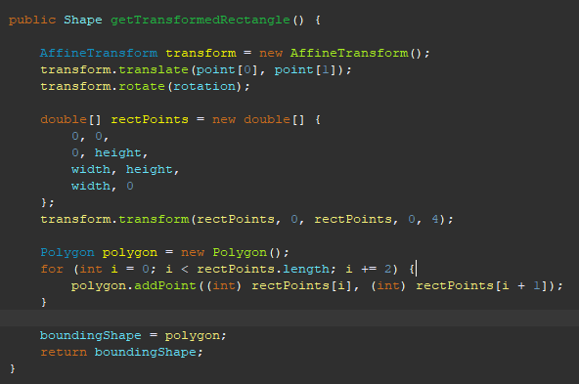
PROBLEM /
CHALLENGE
Barriers not colliding
The drawOn method does not preserve the location of the shape
AffineTransform allows for transformations to be performed on a shape
Notes:
Nicolas

Slide 11
Thank You

